Slide 1
TUTORIAL - 5
Interpretation

Slide 2
Project Management Tree Swing Scenario

Slide 3
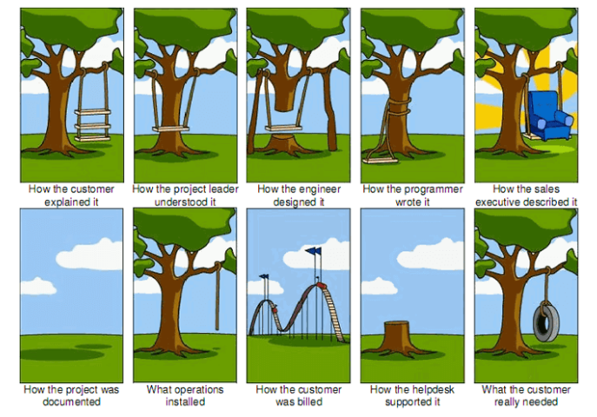

Slide 4
Template:
The diagram shows ____. The process involves ____. As a result, ____.
One can describe it as a process mentioned in steps with arrows.
The arrows are used to define the direction of steps.
It should not be difficult to describe as you just have to follow the request while reading the steps in your response.

